Slide 1
Machine Learning

Slide 2
What is Machine Learning
Machine Learning is a process of Teaching computers or recognized patterns in data and make decision.
Machine Learning is a branch of AI that enable computers to learn from data.

Slide 3
Types of Machine Learning
Supervised ML
Unsupervised ML
Semi-Supervised ML
Reinforcement ML

Slide 4
Supervised Machine Learning
Supervised machine learning is type of ML where a model is trained using Labeled data.
Labeled means: input data already has correct answer...
There are two types of Supervised Machine Learning
Regression
Classification

Slide 5
Regression
Regression is a type of supervised machine learning where the model predicts a continuous numerical value based on input data.
Examples: Predicting house price based on size, location, etc.
Regression Algorithms
1. Linear Regression
2. Polynomial Regression
3. Ridge Regression
4. Lasso Regression

Slide 6
Linear Regression
Linear Regression a Supervised Machine Learning Algorithm that is used to predict a number(Continuous value) by finding the relationship between Input and output using straight line
Note:- Linear Regression draws the best straight line through data points to make predictions.
Linear Regression equation is Y=mx+c

Slide 7
Types of Linear Regression
Simple Linear Regression:- use one independent variable(x) to predict one dependent variable(y).
Equations :- y=mx+c
Multiple Linear Regression:- used two or mare independent variables to predict one output.
Equations :- y=m1x1+m2x2+m3x3+c
where y=predict output
x1,x2,x3=inputs variables
m1,m2,m3=coefficients
c=intercept

Slide 8
Polynomial Regression
Polynomial Regression is used to when the relationship between variables is not a straight line but a curve.
Equation :- y=m1x+m2x^2+m3x^3+c
where y=predict output
m1,m2,m3=Coefficients
C=intercept

Slide 9
Ridge Regression
Ridge Regression is a type of Linear Regression that is used to reduce the overfitting when model has many features.
Note:- It improves the model by adding a penalty term.
Equation:- Loss=RSS(Error)+λ∑(m^2​)
where RSS= Residual sum of square (error)
λ=regularization parameter
m^2= square of coefficients

Slide 10
Lasso Regression
Lasso Regression reduce the overfitting and perform feature selection.
Note:- It not only controls overfitting but also removes unnecessary features.
Equation:- Loss=Error+λ∑∣m∣
Where |m|=absolute value of coefficient.

Slide 11
Classification
Classification is a type of supervised machine learning where the model predicts a category (label) instead of a number.
Example:- Student result → Pass or Fail
Classification Algorithms
Logistic Regression
K-NN
Decision Tree
Random Forest

Slide 12
Logistic Regression
Logistic Regression :- That is used for Classification Problems especially when the output has two possible classes.
For Example yes/no , 0/1 and Ture/False.
Logistic Sigmoid Function : - Uses of the Sigmoid function to convert the value into Probabilities(0/1).
Formula:- σ(z) = 1 / (1 + e^(-z))
Where σ(z) =Sigmoid Function
z=input value
e=Euler number

Slide 13
Types of Logistic Regression
Binary Logistic Regression :- Used when there are only two possible classes.
Example:
If probability ≥ 0.5 → Class 1
If probability < 0.5 → Class 0
Multinomial Logistic Regression :- Used when there are more than two classes and no order between them.
Example:-
Fruit classification → Apple, Banana, Mango
Animal classification → Dog, Cat, Cow
Ordinal Logistic Regression :- Used when there are multiple classes with order.
Example:- Education level → High School, Bachelor, Master, PhD

Slide 14
Decision Tree
Decision Tree is a machine learning algorithm that splits data into smaller parts based on conditions, checks these conditions step by step, and finally makes a prediction or decision.
Types of Decision Tree
Classification Tree: A decision tree used to predict categorical outcomes.
Regression Tree: A decision tree used to predict continuous numerical values.

Slide 15
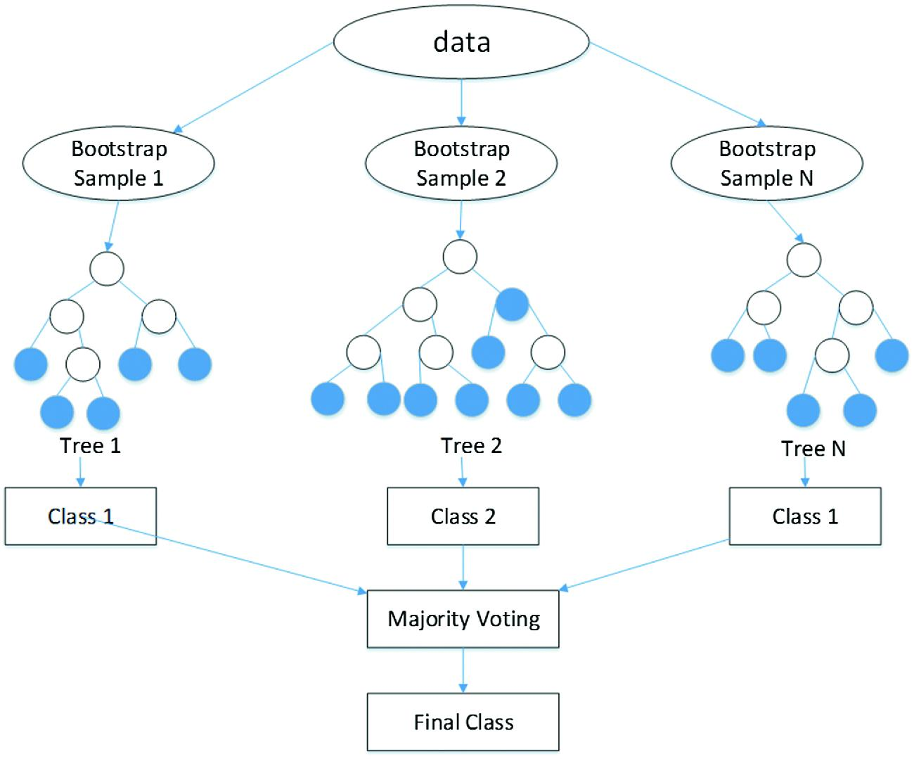
Random Forest
Random Forest is a machine learning algorithm that uses multiple decision trees together to make a better and more accurate prediction

